Slide 1
Lecture-2 Sequential Circuit Design Counters

Slide 2
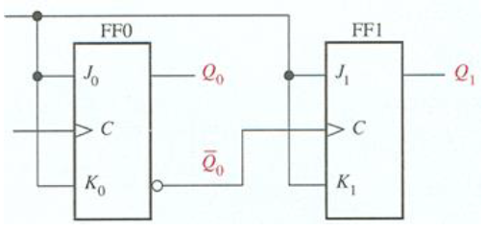
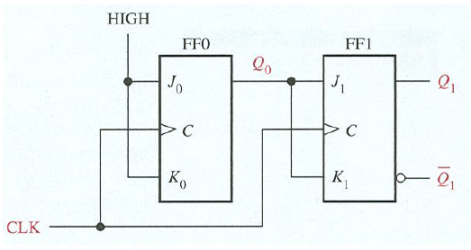
Asynchronous Counter
COUNTERS: Counters in digital circuit are devices used for counting. These are sequential circuits made of flip-flops. There are two broad categories of counters, namely,
Asynchronous Counters are counters where the flip-flops do not have a common clock and so they do not change states at the same time.
Synchronous Counters are counters where the flip-flops have a common clock and so the flip-flop changes its states at the same time.
The clock is not common
The clock is common

Slide 3
Asynchronous Counter
Flip-Flops are not connected to a common clock.
Flip-Flops do not change their state at the same time.
JK flip-flops are used in toggle mode of operation.
Common Asynchronous Counter
Asynchronous Binary Counters
2- Bit Binary Counters
3- Bit Binary Counters
4- Bit Binary Counters
Asynchronous Decade Counter ( MOD-10)
Asynchronous Modulus Twelve Counter

Slide 4
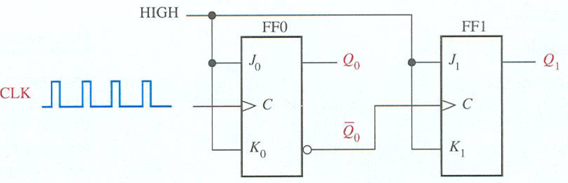
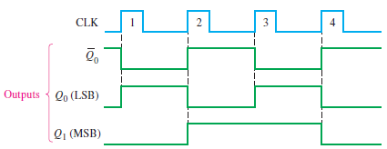
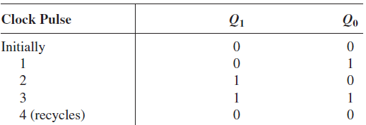
2-Bit Binary Asynchronous Counter

Slide 5
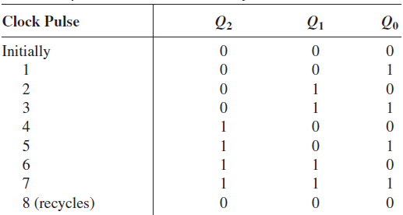
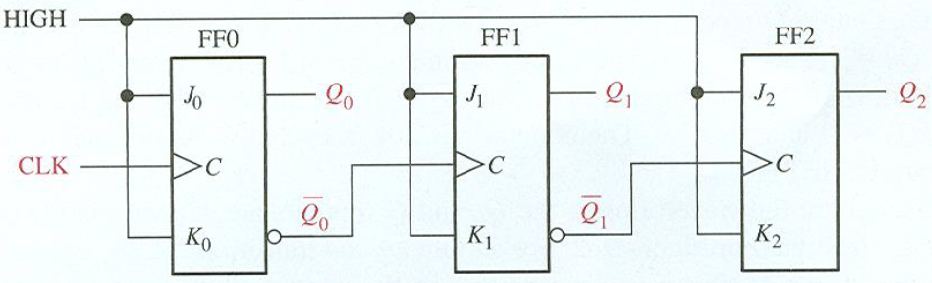
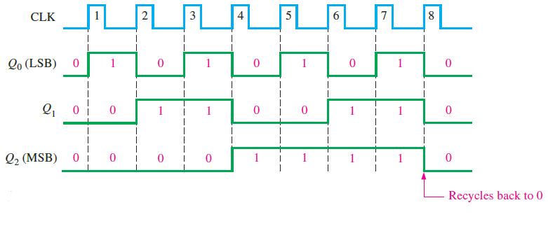
3-Bit Binary Asynchronous Counter

Slide 6
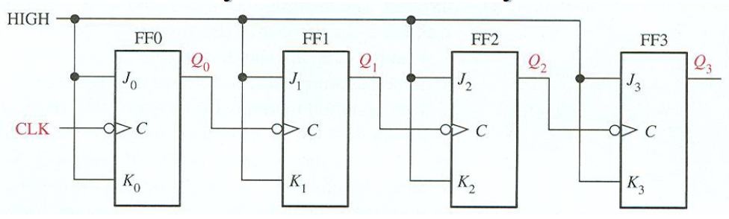
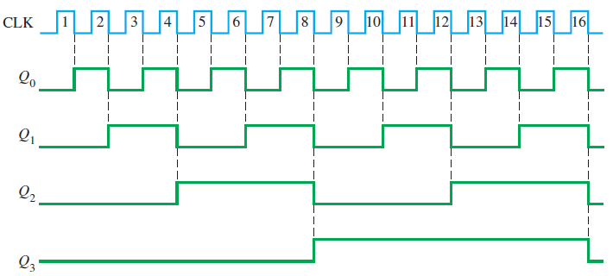
4-Bit Binary Asynchronous Counter

Slide 7
MOD Counters
A counter with N flip-flops can count to 2^{N} sequences.
The modulus of a counter in number of unique sequence that a counter can count through.
The MOD counters do not complete the entire count sequence.
These type of sequence is called truncated sequence.
An example of such counter can be MOD-11 counter.
A MOD-11 counter has 4 flip-flops (as we require 4-bits to count up to 11)
With 4 flip-flops the complete count sequence is 16 (0 to 15).
However, a MOD-11 counter will have only 11 sequences (0 to 10).
Thus we need to figure out a way to reset the flip-flop when the counter reaches the 12th sequence (no. 11).
This is where the asynchronous clear input becomes very handy.
So we can decode the 12th state to reset the counter.

Slide 8
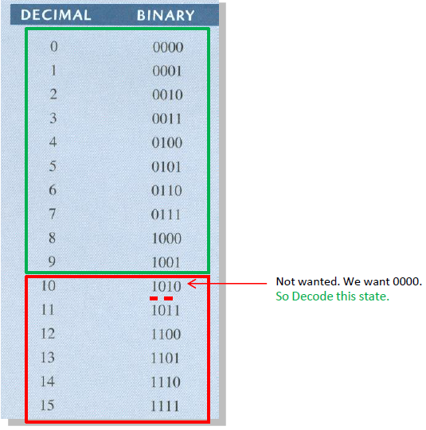
Asynchronous Decade Counter (MOD-10)
The most popular MOD counter is the Decade Counter.
Counters with 10 sequences are called Decade Counters.
It can count 10 sequence that is 0 to 9.
Thus it is also called a BCD counter.
It has a wide range of application from displays to digital watches.
The counter counts from 0000 to 1001.
Then when counter reach 1010 the counter resets.
So the state 1010 is decoded to reset the counter.
Since we do not want the states after 1001, at 1010 we force clear the counter and restart counting from 0000.

Slide 9
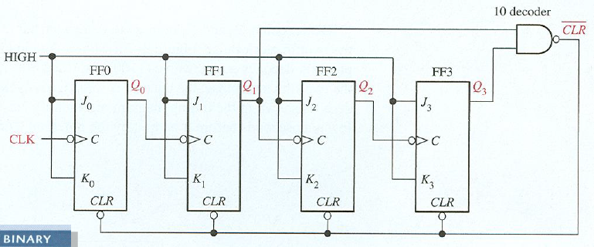
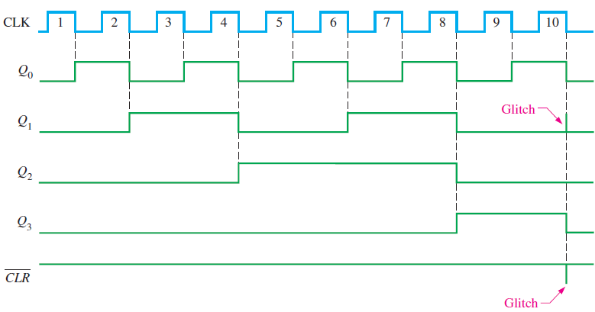
Asynchronous Decade Counter (MOD-10)
To decode 1010, we can only use the outputs Q₃ and Q₁. NAND of Q₁ and Q₃ produces a 0 when both Q₁ and Q₃ are 1. And the output of the NAND gate is used to clear the flip-flops
As the counter changes its state from 1001 to 1010(for fraction of seconds), the counter is reset by the help of clear. This produces the glitch

Slide 10
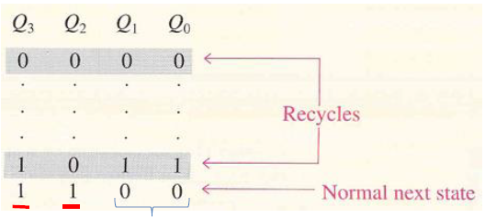
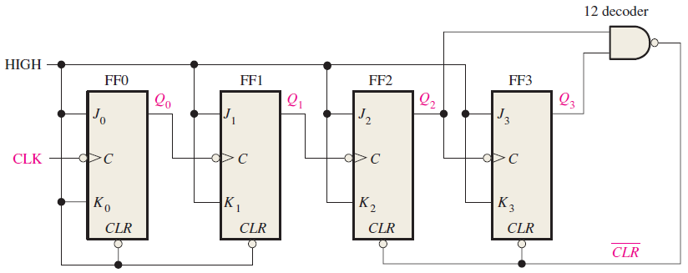
Asynchronous MOD-12 Counter
At state 0000 and 1100 Q₀ and Q₁ are already 0 so need to clear these two flip-flops.
NAND of Q2 and Q3 at 1100 state produces a 0 which clears FF2 and FF3.

Slide 11
Synchronous Counter
Flip-Flops are connected to a common clock.
Flip-Flops change their state at the same time.
JK flip-flops are used.
The design is complex compared to asynchronous counters.
Common Synchronous Counter
Synchronous Binary Counters
2- Bit Binary Counter
3- Bit Binary Counter
4- Bit Binary Counter
Synchronous BCD Decade Counters
Up/ Down Synchronous Counters
Irregular Sequence Counters

Slide 12
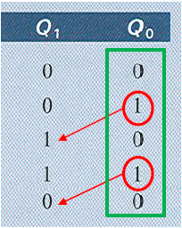
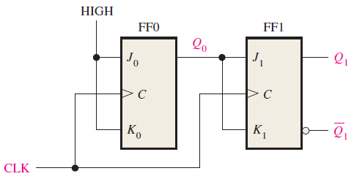
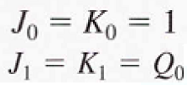
2-Bit Synchronous Counter
2-Bit Binary Counter count from 0 up to 3 and then resets.
Unlike asynchronous counter we need find the inputs to the flip-flop.
The first bit alternates at every clock
So the first flip-flop can be used in toggle mode.
But for the second bit we need to find the pattern that toggles the bit.

Slide 13
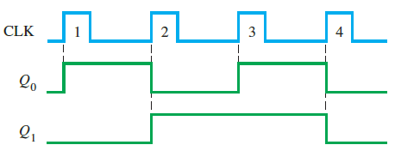
2-Bit Synchronous Counter

Slide 14
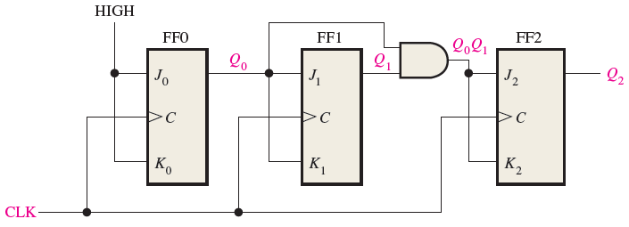
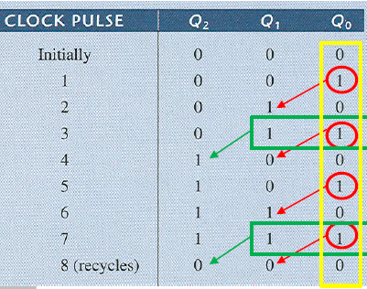
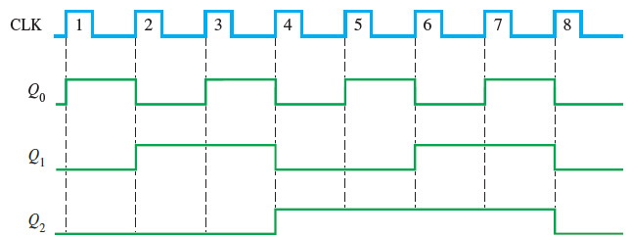



3-Bit Synchronous Counter

Slide 15
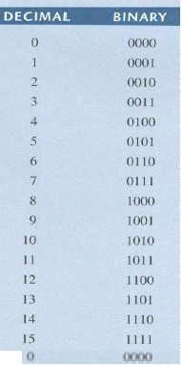
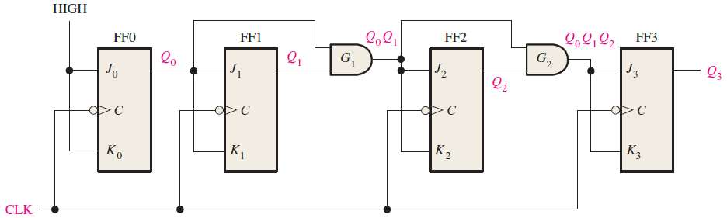
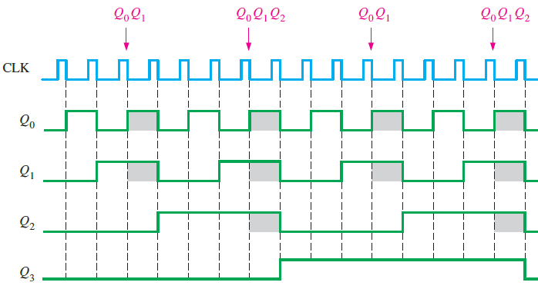

4-Bit Synchronous Counter

Slide 16
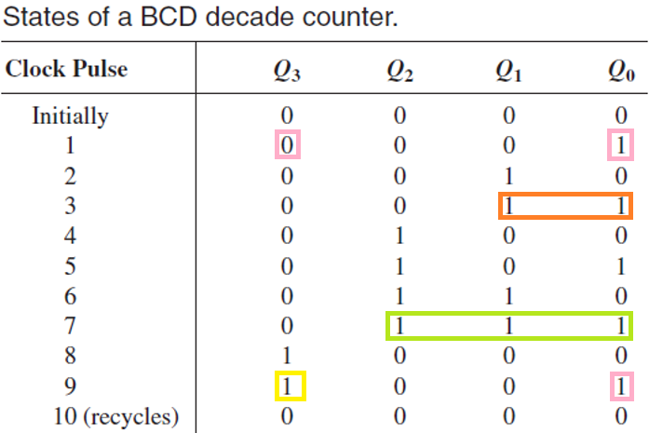
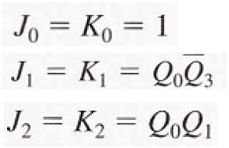


Synchronous BCD Decade Counter
Why do we need $\overline{Q_{3}}$??
Why do we need

Slide 17
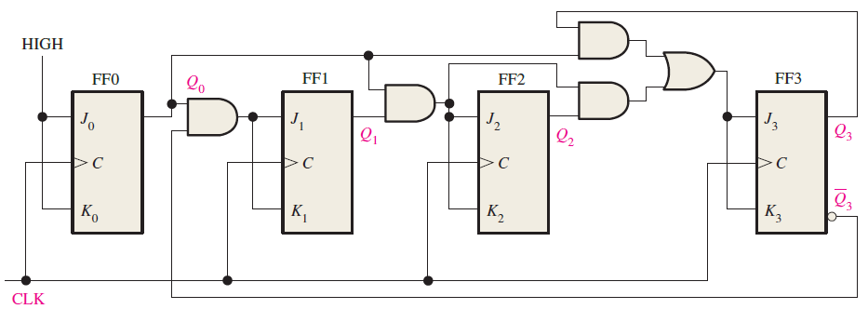
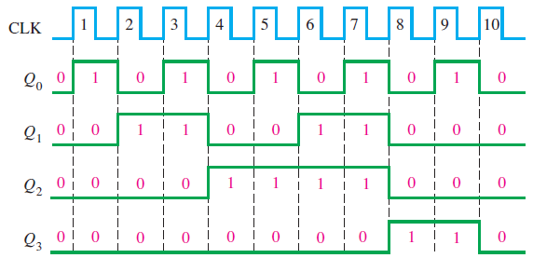
Synchronous BCD Decade Counter

Slide 18
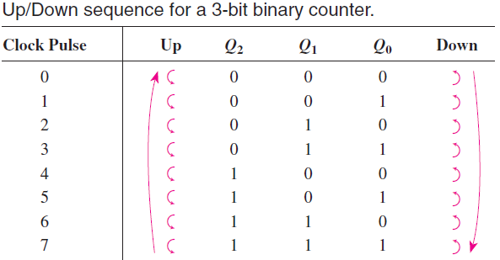
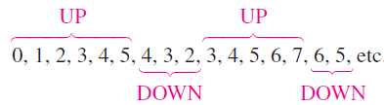
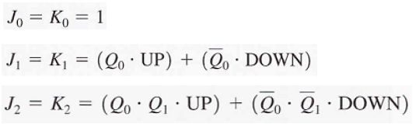
Up-Down Synchronous Counter
An up/down counter is one that is capable of progressing in either direction through a certain sequence.
It is also called a bi-directional counter.
In general most up/down can be reversed at any point in their sequence

Slide 19
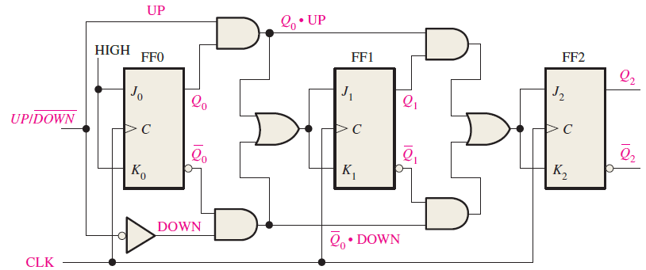
Up-Down Synchronous Counter

Slide 20
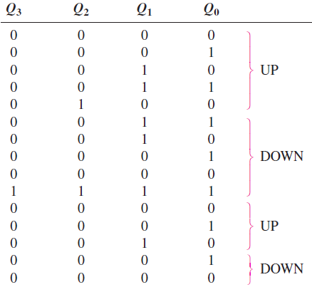
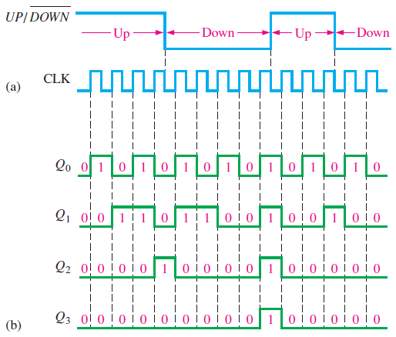
Up-Down Synchronous Counter

Slide 21
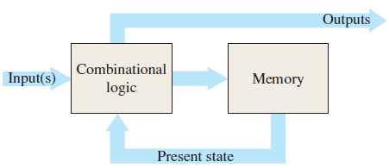
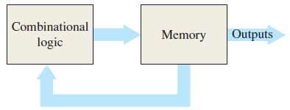
Irregular Sequence Counter
To design an irregular sequence counter we need to first understand the concept of state machines. A state machine is a sequential circuit having a finite number of states occurring in prescribed order. There are generally two types of state machines, namely, Moore State Machine and Mealy State Machines.
Moore Machine
Mealy Machine
State Machines have a finite number of state and they go about it in a prescribed manner.
The order of sequence is described with the help of a state diagram.
A state diagram is a diagram which shows the progression of states through which the counter advances when it is clocked.

Slide 22
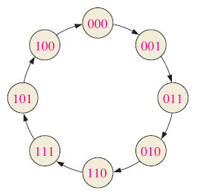
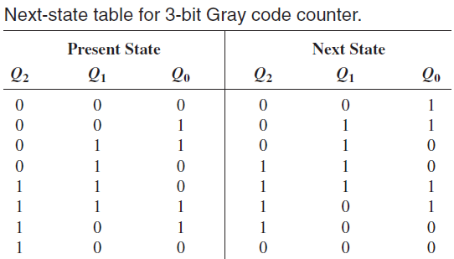
Irregular Sequence Counter (Gray Code Counter) Design
Step1: Develop a state Diagram
Step2: Develop a Next-state table.
Step3: Create a flip-flop transition table.
Step4: Use Karnaugh-map to derive the logic requirements.
Step5: Implement a counter to produce the specific sequence of states.
STEP 1
STEP 2

Slide 23
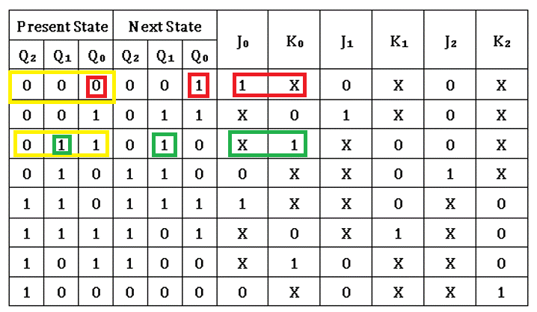
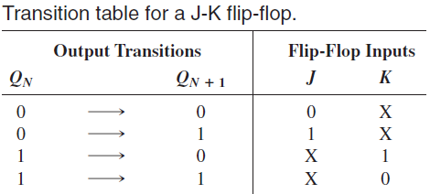
Irregular Sequence Counter (Gray Code Counter) Design
STEP 3
Once the table is populated, considering present state as output K-Map for J and K for the three flip-flops are filled and the logic requirements are found.

Slide 24
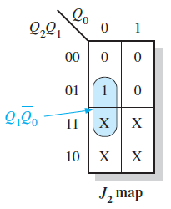
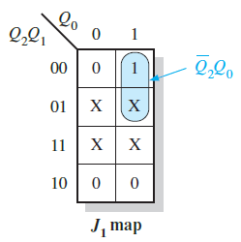
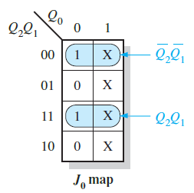
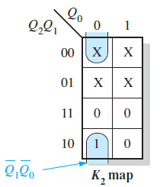
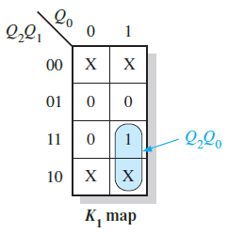
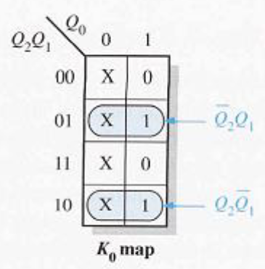
Irregular Sequence Counter (Gray Code Counter) Design
STEP 4

Slide 25
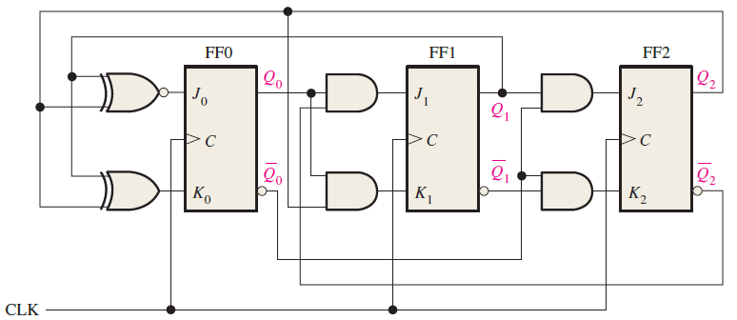
Irregular Sequence Counter (Gray Code Counter) Design
3-Bit Gray Code Counter Circuit
STEP 5

Slide 26
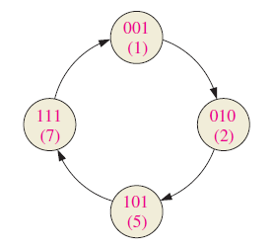
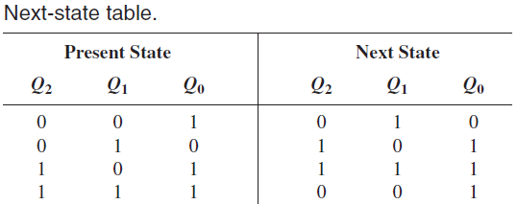

Irregular Sequence Counter Design
Design a counter with the sequence 1,2,5 and 7.

Slide 27


Irregular Sequence Counter Design

Slide 28


Irregular Sequence Counter Design
FROM THE K-MAP
The implementation of the counter for the given states

Slide 29


Irregular Sequence Counter Design
State Diagram

Slide 30


Irregular Sequence Counter Design

Slide 31

Irregular Sequence Counter Design
Logic Requirements for the inputs J and K:
Please draw the circuit for the counter on your own!!!!!!!!!!

Slide 32
References
Thomas L. Floyd, “Digital Fundamentals” 11th edition, Prentice Hall – Pearson Education.
Thank You

